Slide 1

Data Analytics in
Supply Chain
Kumaravel D
“ The future of supply chain will rely heavily on data integrity and how that information is mined and managed to increase supply chain agility and resiliency.” - Joe Armstrong (EY)
Notes:
To use this title animation slide with a new image simply 1) move the top semi-transparent shape to the side, 2) delete placeholder image, 3) click on the picture icon to add a new picture, 4) Move semi-transparent shape back to original position, 5) Update text on slide.

Slide 2
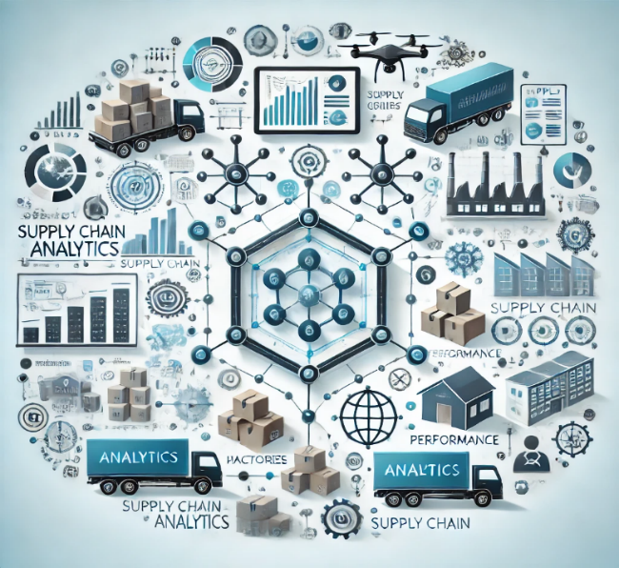
What is supply chain analytics?
Supply Chain Analytics (SCA) refers to the use of data analysis, statistical methods, and advanced technologies (like Artificial Intelligence and Machine Learning) to optimize, monitor, and improve supply chain processes. It focuses on extracting actionable insights from the vast amounts of data generated in supply chain operations to enhance efficiency, reduce costs, and improve decision-making.

Slide 3
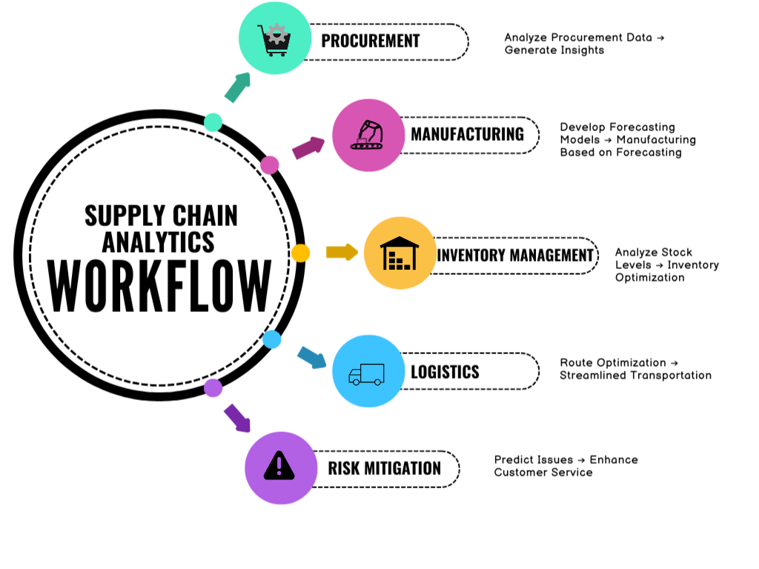

Slide 4
Key features of effective supply chain analytics
The supply chain is the most obvious face of the business for customers and consumers. The better a company can perform supply chain analytics, the better it protects its business reputation and long-term sustainability.
Key features of effective supply chain optimization include:
Connect
Collaborative
Cyber-aware
Cognitive enabled
Comprehensive
Being able to access unstructured data from social media, structured data from the Internet of Things (IoT) and more traditional data sets available through traditional ERP and B2B integration tools.
Improving collaboration with suppliers increasingly means the use of cloud-based commerce networks to enable multi-enterprise collaboration and engagement.
The supply chain must harden its systems from cyber-intrusions and hacks, which should be an enterprise-wide concern.
The AI platform becomes the modern supply chain’s control tower by collating, coordinating and conducting decisions and actions across the chain. Most of the supply chain is automated and self-learning.
Analytics capabilities must be scaled with data in real-time. Insights will be comprehensive and fast. Latency is unacceptable in the supply chain of the future.

Slide 5
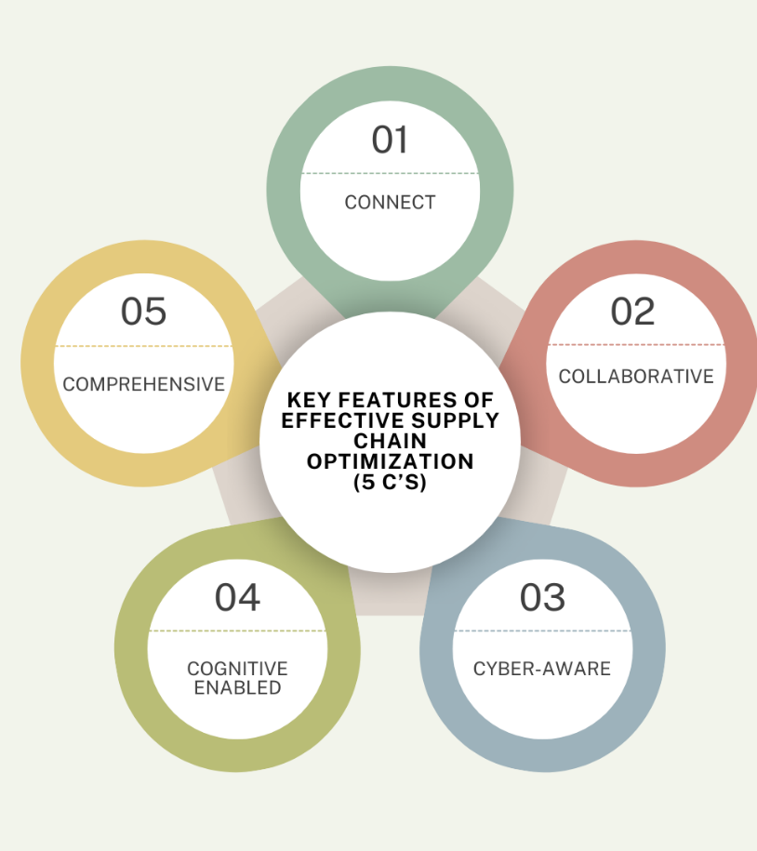

Slide 6
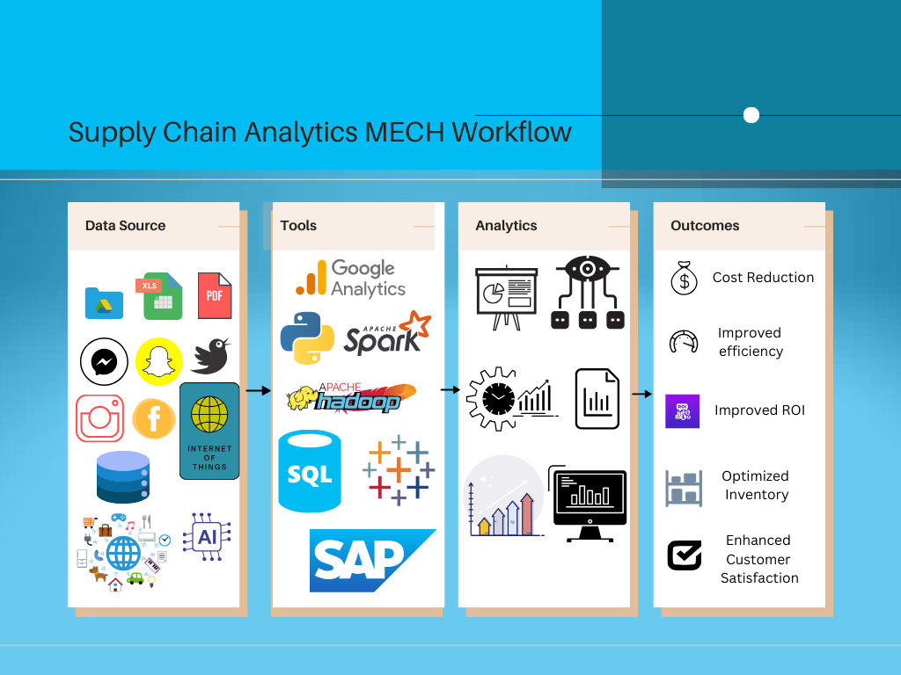

Slide 7
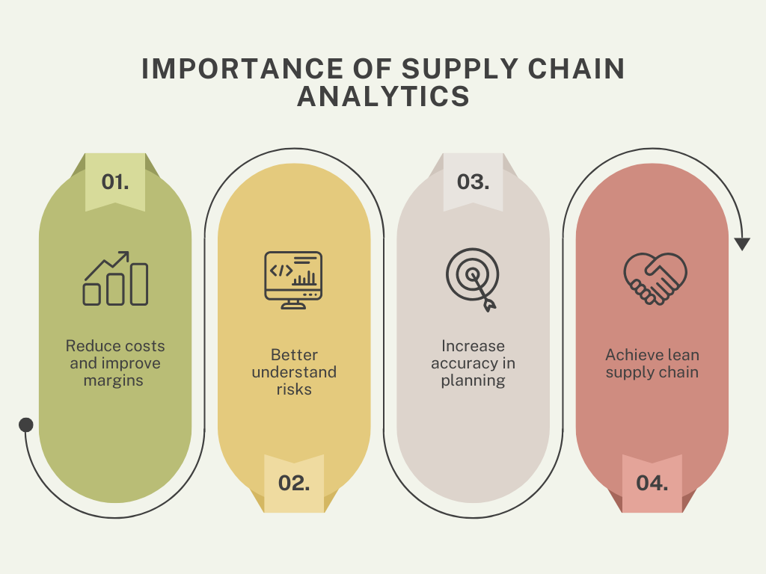
Why is supply chain analytics important?
1.Reduce costs and improve margins
Access comprehensive data to gain a continuous integrated planning approach and real-time visibility
2. Better understand risks
Supply chain analytics can identify known risks and help to predict future risks by spotting patterns and trends
3. Increase accuracy in planning
By analyzing customer data, supply chain analytics can help a business better predict future demand
4. Achieve lean supply chain
Companies can use supply chain analytics to monitor warehouse, partner responses and customer needs for better informed decisions.

Slide 8
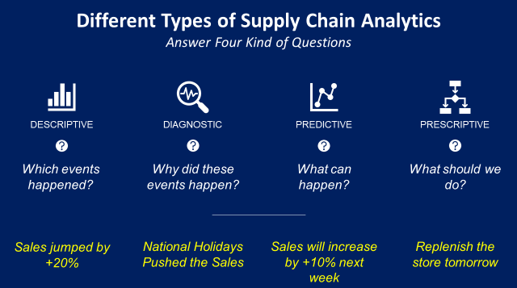
What are the types of supply chain analytics?
Different types of supply chain analytics include: 1. Descriptive analytics 2. Predictive analytics 3. Prescriptive analytics 4. Diagnostic analytics
Notes:
Tip:
When using complex image as full-bleed background add a transparency (70%-90%) fill layer to give contrast to text.

Slide 9
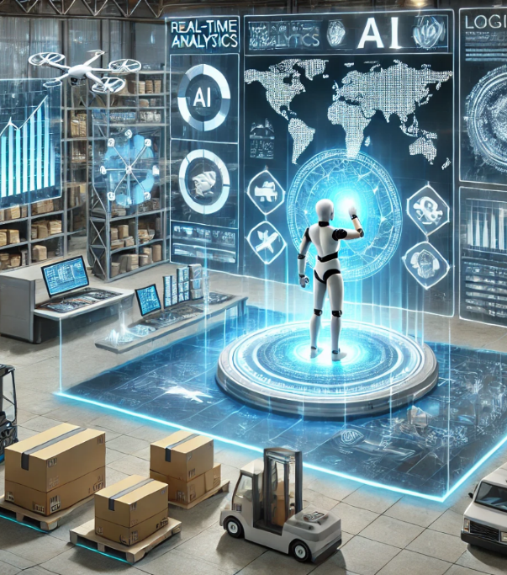
The Future of Supply Chain Analytics
1. Artificial Intelligence (AI) and Machine Learning
The ongoing progression of AI and machine learning algorithms imply that their implementation in supply chain analytics will keep expanding. These advancements possess the potential to transform supply chain management by automating intricate tasks, recognizing patterns and trends that may elude human perception, and empowering businesses to make more precise forecasts and decisions.

Slide 10

2. Internet of Things (IoT)
The Internet of Things (IoT) denotes a system of linked devices, sensors, and software that gather and share data. With an increasing number of devices being connected, the quantity of data open for analysis will surge exponentially. This data will furnish fresh perspectives on supply chain operations, permitting businesses to enhance their processes and amplify efficiency.

Slide 11

3. Blockchain Technology
The prospective influence of blockchain technology on supply chain analytics is substantial as it offers a secure, transparent, and decentralized approach to tracking goods and transactions throughout the supply chain. This augmented visibility and traceability can facilitate businesses in recognizing bottlenecks, guaranteeing the genuineness of their products, and diminishing the likelihood of fraud and counterfeit goods.

Slide 12

BUSINESS IMPACT
Enhanced Demand Forecasting: Companies leveraging data analytics in demand forecasting have seen 15-20% cost reduction by accurately predicting customer demand and reducing excess inventory and stockouts.
Improved Operational Efficiency: Data analytics can improve operational efficiency by up to 30% by minimizing delays, improving production scheduling, and optimizing resource usage across supply chains
Increased Supply Chain Visibility: Enhancing visibility through data can help prevent disruptions, reduce lead times by 20-30%, and improve communication across the supply chain.
Enhanced Supplier Management: By utilizing data analytics to assess supplier performance, companies can reduce procurement costs by 10-15% and improve supplier relationships, ensuring timely deliveries and better pricing.
Risk Mitigation: Predictive analytics can reduce supply chain disruptions by 10-20% by helping organizations anticipate and proactively address potential risks.

Slide 13
Market Trends

Slide 14
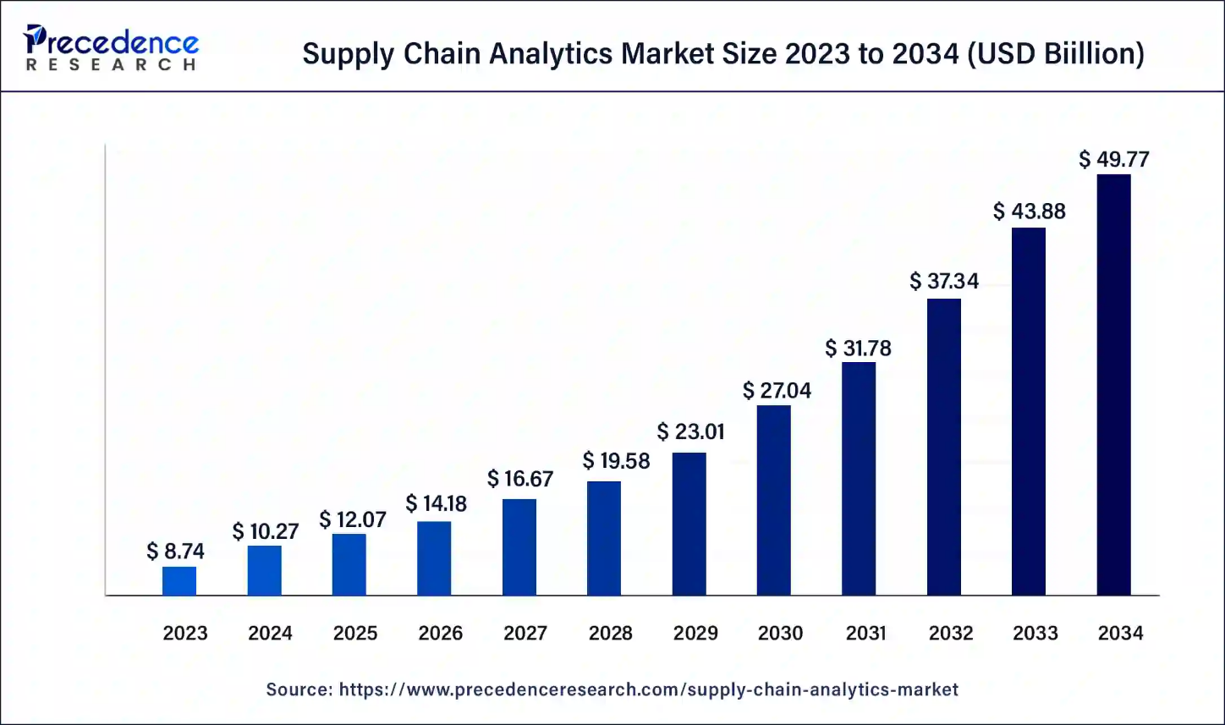
The global supply chain analytics market size accounted for USD 10.27 billion in 2024 and is predicted to reach around USD 49.77 billion by 2034 with solid a CAGR of 17.51% from 2024 to 2034

Slide 15
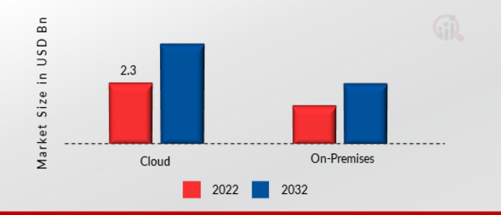
The Supply Chain Analytics Market segmentation, based on deployment models, includes on-premises, cloud. In 2022, the cloud sector showed the highest share of the market of more than 60% based on deployment type.

Slide 16
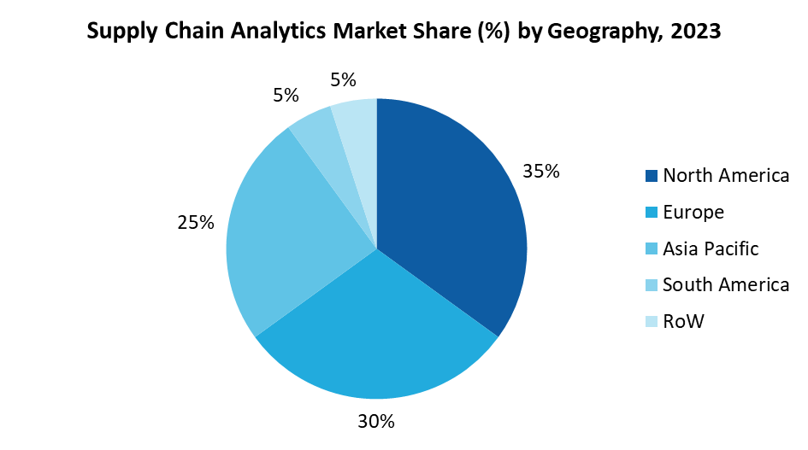
By region, the supply chain analytics market is led by North America, holding over 35% market share in 2023, driven by a focus on operational data visualization. Europe is the second-largest market, with Germany leading and the UK as the fastest-growing. Asia-Pacific is expected to grow at the fastest CAGR (2023–2032), fueled by increased adoption of analytics by SMBs and rising tech investments, with China leading and India as the fastest-growing market in the region.

Slide 17
Supply Chain Analytics Market Key Takeaways
North America has generated more than 37% of revenue share in 2023.
Asia Pacific region is expected to expand at the fastest CAGR between 2024 and 2034.
By Solution, the sales and operations segments held the largest market share of over 26% in 2024.
By Service, the professional segment is expected to expand at the fastest CAGR between 2024 and 2034.
By Deployment, the cloud segment is predicted to grow the greatest CAGR from 2024 to 2034.
By Enterprise Size, the large-scale enterprise segment is predicted to dominate the global market between 2024 and 2034.

Slide 18

Case Study: Amazon's Supply Chain Optimization
Background:
Amazon, a global e-commerce giant, has one of the most complex supply chains in the world. To maintain its competitive edge and ensure timely delivery, Amazon has heavily invested in data analytics to optimize its supply chain operations.

Slide 19




IMPLEMENTATION:
Data Collection: Amazon collects vast amounts of data from various sources, including customer orders, inventory levels, supplier performance, and delivery times.
Advanced Analytics: The company uses advanced analytics techniques, such as machine learning and predictive analytics, to analyze this data. This helps in predicting demand, optimizing inventory levels, and improving delivery routes.
Real-Time Monitoring: Amazon implemented real-time monitoring systems to track inventory levels and supply chain activities. This allows for quick responses to any disruptions or changes in demand.
Automation: Amazon uses robotics and automation in its warehouses to streamline operations and reduce human error.

Slide 20
RESULTS:
Inventory Reduction: Amazon reduced its inventory levels by 20%, leading to significant cost savings.
Improved Forecast Accuracy: The use of predictive analytics improved demand forecasting accuracy by 30%, reducing stockouts and overstock situations.
Cost Savings: Overall supply chain costs were reduced by 15% due to optimized inventory management and improved supplier collaboration.
Enhanced Customer Satisfaction: With better inventory management and timely stock replenishment, customer satisfaction levels increased, leading to higher sales and customer loyalty.

Slide 21
Conclusion
Modern supply chain management is not helpful without data analytics and digital systems. You must understand how data analytics work and how it impacts inventory management, transportation costs, and demand forecasting.
Lastly, leveraging data analytics allows you to improve supplier performance, reduce lead times, enhance customer service, increase supply chain visibility, minimize environmental impact, and boost operational efficiency.

Slide 22
THANK YOU!

